Slide 1
Driver Riskometer:

Slide 2
Outlines
Introduction
What is Driver Riskometer?
Benefits of Driver Riskometer
User Study

Slide 3
Introduction
Number of mobile users in the UAE exceeded 7.74 million in 2009 while UAE population is currently stands at 6 million
Driving is very important in (UAE) Due to the extreme hot weather and high humid conditions
Average Commute Time Per day
Sharjah to Dubai –> 2 hours and 44 minutes
Dubai –> 1 hour 45 minutes
Sharjah –> 1 hour 8 minutes
Abu Dhabi –> 48 minutes
Notes:
GulfTalent.co has actually conducted a survey of the following issue and the results were somewhat of a surprise. The study involved 5000 professionals from 14 different middle eastern cities and the results were as follows: Average Commute Time Per day: Total Return Journey (To and From work) by Place of Work Dubai –> 1 hour 45 minutes (Sharjah to Dubai –> 2 hours and 44 minutes) Cairo –> 1 hour 33 minutes Sharjah –> 1 hour 8 minutes Doha - –> 56 minutes Dammam –> 55 minutes Beirut –> 55 minutes Kuwait –> 55 minutes Amman –> 53 minutes Riyadh –> 49 minutes Abu Dhabi –> 48 minutes Muscat –> 48 minutes Manama –> 48 minutes Khobar –> 47 minutes Jeddah

Slide 4
Introduction
Traffic accidents are the second leading cause of death in UAE[1] and number one cause of childhood death in UAE[2]
Car crashes costing UAE Dh21 billion a year.[3]
Abu Dhabi still has one of the world's highest rates of road death - an incidence of 20.2 deaths per 100,000 population in 2009.[4]
Nationals are nearly twice as likely to die in road accidents as Non-Nationals, and young men (<35 years old) are the most likely to die. [5]
Notes:
[1] http://gulfnews.com/news/gulf/uae/traffic-transport/traffic-accidents-are-second-leading-cause-of-death-in-uae-1.89596
[2] http://www.ameinfo.com/172703.html
[3]http://webcache.googleusercontent.com/search?q=cache:HdiE_oOOiesJ:www.thenational.ae/apps/pbcs.dll/article%3FAID%3D/20100403/NATIONAL/704029790/1010+uae+TRAFFIC+ACCIDENTS+COST+MILLION+PER+ANNUM.&cd=2&hl=en&ct=clnk
[4] http://www.zawya.com/printstory.cfm?storyid=ZAWYA20100323125127&l=125100100323
[5] http://www.haad.ae/haad/tabid/228/Default.aspx

Slide 5
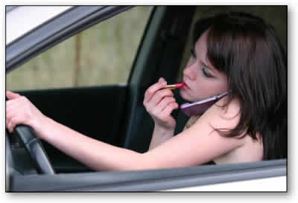
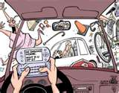
Driving and mobile use is a fatal combination
80% of crashes and 65% of near-crashes involve some form of driver distraction within 3 seconds before the crash.[1]
Over 86 per cent of road accidents are the result of human error[4]
71.7% of male and 64.6 % of female drivers in UAE use mobile phone while driving.[2]
Notes:
[1]Neale, V.L., Dingus, T.A., Klauer, S.G., Sudweeks, J. & Goodman, M. (2005). An overview of the 100-car study and findings. Paper No. 05-400. U.S. Department of Transportation DOT, National Highway Traffic Safety Administration NHTSA. Washington, D.C.
[2]Bener A, Crundall D, Haigney D, Bensiali AK, Al-Falasi ”Driving behaviour, lapses, errors and violations on the road: United Arab Emirates study”. Advances in Transportation Studies an international Journal,2007.
[4] http://gulfnews.com/news/gulf/uae/traffic-transport/traffic-accidents-are-second-leading-cause-of-death-in-uae-1.89596

Slide 6
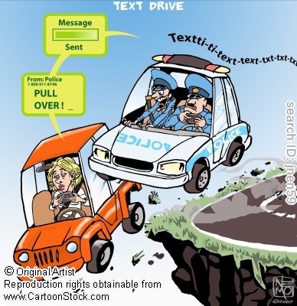
Driving and mobile use is a fatal combination
What makes mobile use so dangerous and why?
Notes:
Drivers who use a mobile phone,
whether hand-held or hands-free:
■ are much less aware of what’s happening on the road around them
■ fail to see road signs
■ fail to maintain proper lane position and steady speed
■ are more likely to ‘tailgate’ the vehicle in front
■ react more slowly and take longer to brake
■ are more likely to enter unsafe gaps in traffic
■ feel more stressed and frustrated.
Research indicates that they are also four times more
likely to crash, injuring or killing themselves and/or
other people.
Using a hands-free phone while driving does not
significantly reduce the risks because the problems are
caused mainly by the mental distraction and divided
attention of taking part in a phone conversation at the
same time as driving.

Slide 7
Driving and mobile use is a fatal combination
Cell Phone Task | Risk Of Crash Or Near Crash Event
Dialing Cell Phone | 2.8 times as high as non‐distracted driving
Talking/Listening to Cell Phone | 1.3 times as high as non‐distracted driving
Reaching for object (i.e. electronic device and other) | 1.4 times as high as non‐distracted driving
Text messaging | 23.2 times as high as non‐distracted driving
Notes:
Box, S. New Data from VTTI Provides Insight into Cell Phone Use and Driving Distraction, 2009.

Slide 8
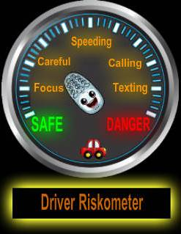
What is Driver Riskometer?
Driver Riskometer: a mobile application that measures and evaluates driver behavior to improve drivers’ awareness and understanding of the risk associated with mobile phone use while driving as well as speeding.

Slide 9
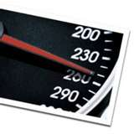

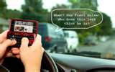
Driver Riskometer Risk factors
Risk factors Driver Riskometer measures:
Speeding
Talking on the phone
Number of dialed or received calls
Duration of dialed or received calls
Typing on the phone
Number of keys interactions
Duration of keys interaction

Slide 10
Driver Riskometer Risk assessment
Driver Riskometer risk assessment algorithm:
Employs a weighted formula to compute the over all risk.
We took into account that texting is the most dangers task, followed by dialing cell phone and finally talking or listening to cell phone

Slide 11
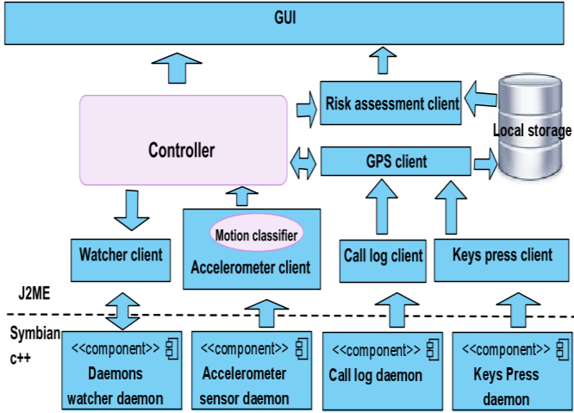
Driver Riskometer system architecture

Slide 12
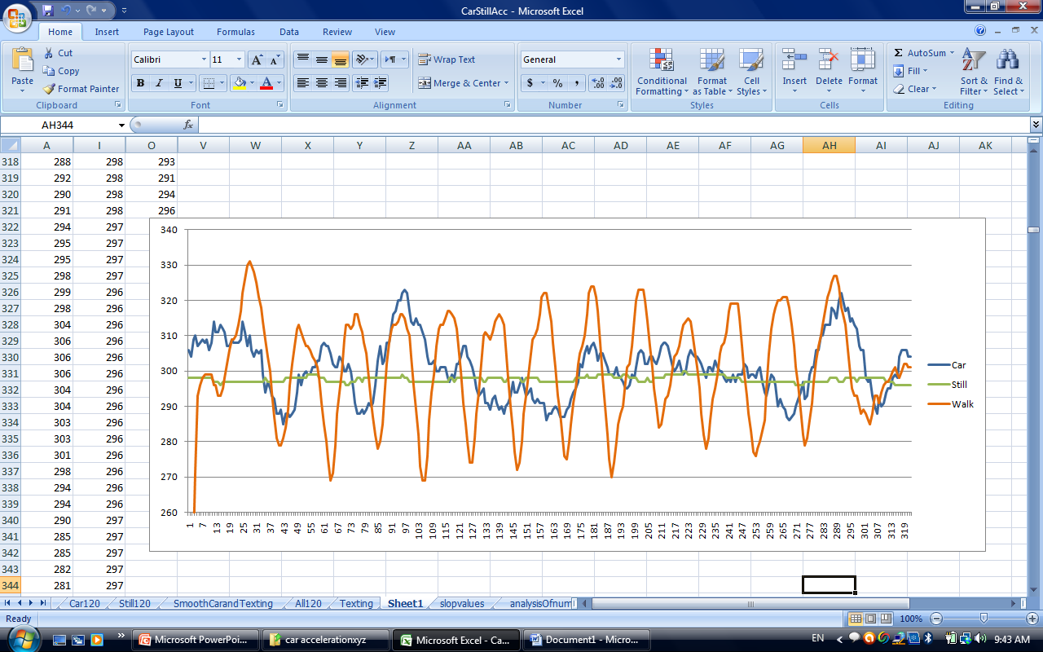
accelerometer daemon
It is Symbian C++ background process to get the acceleration data from N95 8gb internal accelerometer sensor.
Sends the data on midlet requests.
Notes:
Nokai N95 8gb does not support java Mobile Sensor API JSR 256 so we had to build a symbian C++ daemon to get the acceleration data from N95 8gb internal accelerometer sensor. The daemon is build using the mobile native language and using Nokia sensor API. The daemon runs all the time in the background and it wait until the midlet send a signal to starts reading the acceleration data. The daemon keeps sending the acceleration data until it receives a stop signal from the midlet.

Slide 13
Driver Riskometer features
Automatic Start and Stop
Driver Riskometer launches the GPS receiver automatically when you start driving because it detect the car motion using the mobile accelerometer sensor and stop when stop driving for specific period of time.
Benefits:
Save the mobiles battery consumption
Left the burden of remembering to start and stop the application from the user shoulder

Slide 14
watcher daemon
Background Watcher process
Starting the Driver Riskometer application software components in the correct order
Restarting all support daemons when Driver Riskometer fails. Such action is necessary when we cannot reconnect to specific daemons under certain failure conditions

Slide 15
Driver Riskometer Portability
The application main components are developed using java which is a programming language supported by most cell phone manufacturers ex.(Nokia, Samsung, Motorola, Blackberry, Sony Ericsson,…)

Slide 16
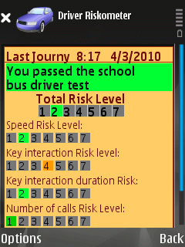
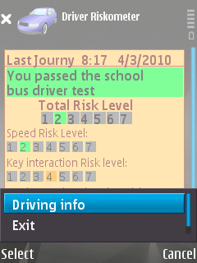
Driver Riskometer
The main view
Main view option menu

Slide 17
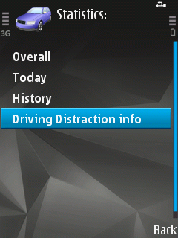
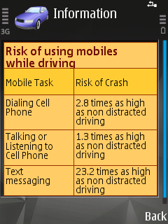
Driver Riskometer
Driving info menu
Driving Distraction info

Slide 18
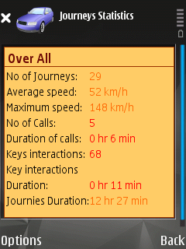
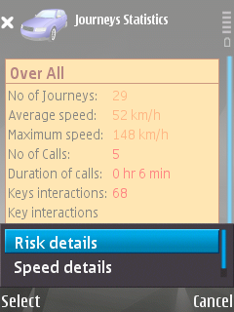
Driver Riskometer
Over All
Over All menu option

Slide 19
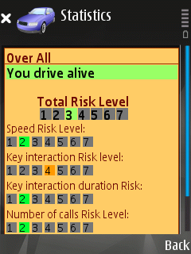
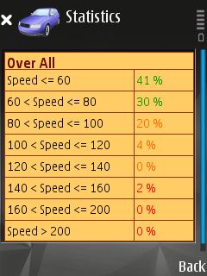
Driver Riskometer
Over all risk details
Over All speed details

Slide 20
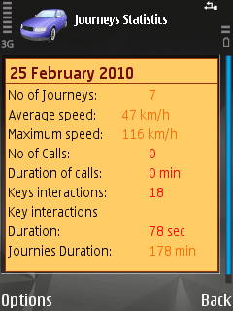
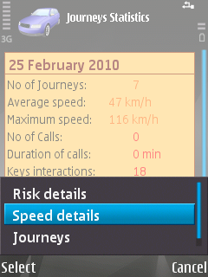
Driver Riskometer
Today
Today menu options

Slide 21
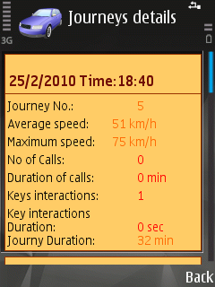
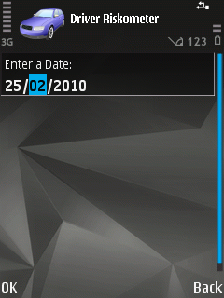
Driver Riskometer
Journeys
History

Slide 22
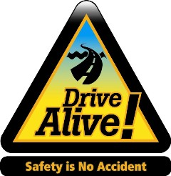
Driver Riskometer
We have 7 risk categories:
So boring you're safe!!!
You passed the school bus driver test
You drive alive
Not too safe and not too risky
Menace to society
Don't drive in my neighborhood
Ticking bomb

Slide 23
Driver Riskometer

Slide 24
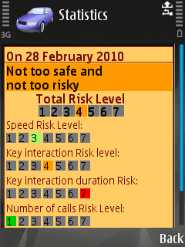
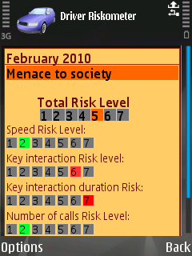
Driver Riskometer

Slide 25
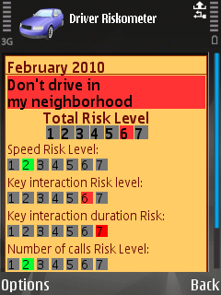
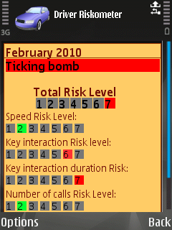
Driver Riskometer

Slide 26
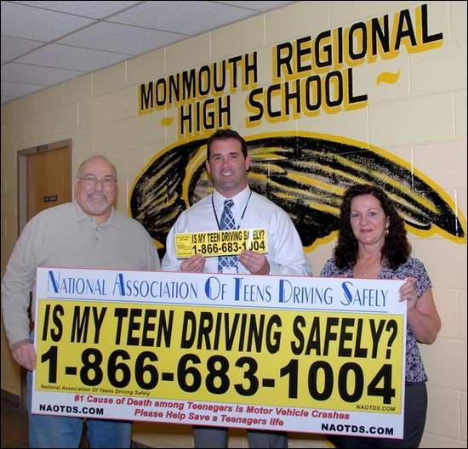
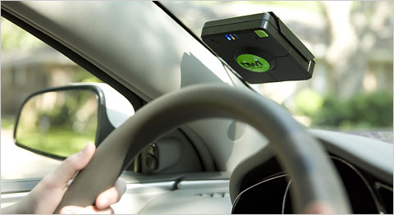
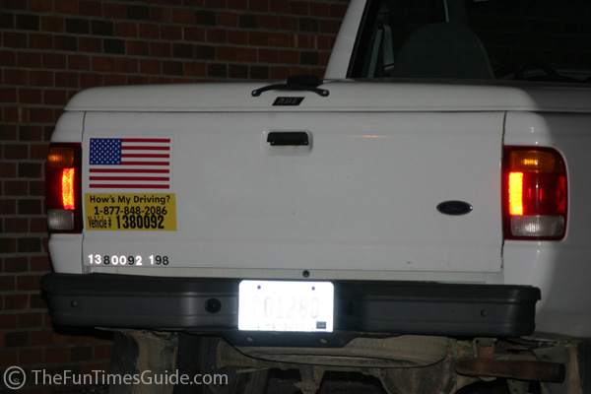
Benefits of Driver Riskometer
Driver Self assessment
Parental Control
Fleet management

Slide 27
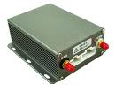
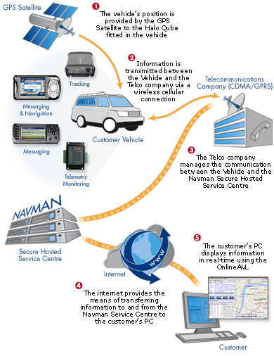
fleet management Solutions
The cost is 1000$ per car per year on average:
Cost of Hardware
Cost of Services
Cost of Maintenance
Standard Vehicle Tracking
Real-time and historic
information about a vehicle’s
location and activity, 24x7.
Information is made available
to any authorized user
with internet access.

Slide 28
Usability Study
The study, conducted over a two-week period, involved 5 males and 7 females.
The average age of the participants is 26 with a standard deviation of 6 years.

Slide 29
Usability Study
9 of the participants used the application in every journey they took, 11 of them said they will continue using it after the study because they like the different type of information it provides
One participant said “I noticed that my driving behavior change when I drive my family. when I drive my family I get level 3 while when I drive alone I tend to get level 5 and 6, my wife become aware of my driving behavior and she warn me from driving dangerously by saying don’t be a ticking bomb today, please”

Slide 30
Usability Study
One participant said “I check my maximum speed after long journeys to see if I have exceeded speed limit and might have been caught by radar.”
Another participant said “I like that for not doing anything I received so much information, I don’t even have to remember to turn it on.”

Slide 31
References
Website:
http://www.gulftalent.com/home/Dubai-Overtakes-Cairo-in-Traffic-Congestion-Article-23.html
http://www.physorg.com/news145628403.html
http://www.quitsmokingmobile.com/
http://en.wikipedia.org/wiki/Fleet_management
http://en.wikipedia.org/wiki/Tachograph
http://news.zdnet.co.uk/emergingtech/0,1000000183,39651006,00.htm
http://news.zdnet.co.uk/emergingtech/0,1000000183,39117340,00.htm
http://news.zdnet.co.uk/communications/0,1000000085,39550718,00.htm
http://images.google.com/imgres?imgurl=http://i65.photobucket.com/albums/h234/kosme515/bilde.jpg&imgrefurl=http://www.kosmetiksnyc.com/blog/the-national-association-of-teens-driving-safely-foundation/&usg=__jDxCDUuS_juVRMsKFZ8m0LqLhQQ=&h=528&w=550&sz=54&hl=en&start=67&sig2=BQ3gAYUlrQeS35LYsQDazQ&um=1&itbs=1&tbnid=PO-973iuUqaqCM:&tbnh=128&tbnw=133&prev=/images%3Fq%3Dis%2Bmy%2Bteen%2Bdriving%2Bsafely%26start%3D54%26um%3D1%26hl%3Den%26sa%3DN%26ndsp%3D18%26tbs%3Disch:1&ei=2HaTS_SwC42-rAepwPmQDA
http://webcache.googleusercontent.com/search?q=cache:HdiE_oOOiesJ:www.thenational.ae/apps/pbcs.dll/article%3FAID%3D/20100403/NATIONAL/704029790/1010+uae+TRAFFIC+ACCIDENTS+COST+MILLION+PER+ANNUM.&cd=2&hl=en&ct=clnk
Paper:
Bener A, Crundall D, Haigney D, Bensiali AK, Al-Falasi ”Driving behaviour, lapses, errors and violations on the road: United Arab Emirates study”. Advances in Transportation Studies an international Journal,2007
1-Neale, V.L., Dingus, T.A., Klauer, S.G., Sudweeks, J. & Goodman, M. (2005). An overview of the 100-car study and findings. Paper No. 05-400. U.S. Department of Transportation DOT, National Highway Traffic Safety Administration NHTSA. Washington, D.C.

